Slide 1
Global problems - tsunami
Boris Berger

Slide 2
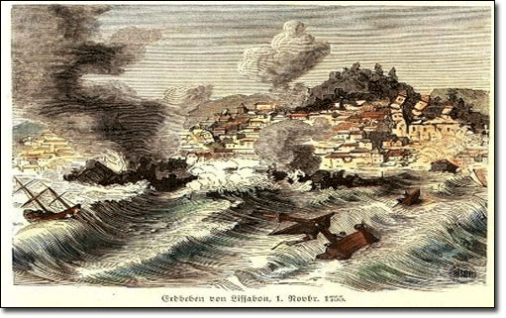
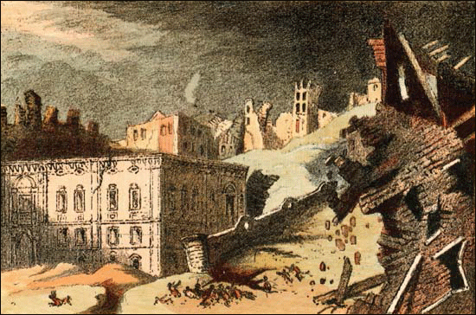
1775, Portugal
In second half of eighteen century hit Portuguese Lisbon powerful earthquake. After earthquake came big waves, which ones destroyed everything on coast.

Slide 3
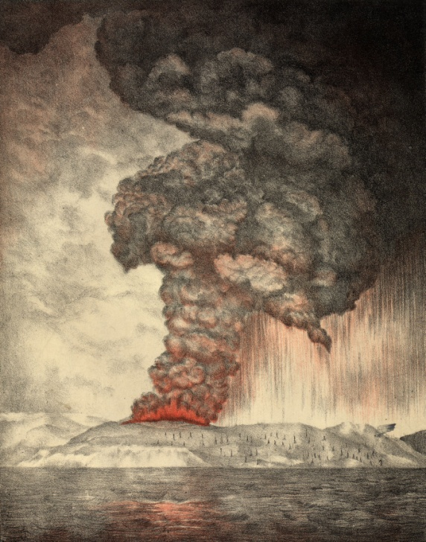
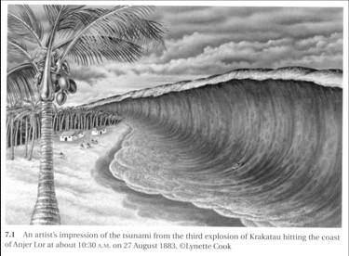
1883, Coast of Sumatra and java
Volcano eruption of Krakatau was been one of the most devastating accident in history of Earth. Everything what outlasted earthquake was been destroyed by 40 meters tall tsunamis. They were observable in Pacific, Atlantic, Indian ocean and in English Channel too.

Slide 4
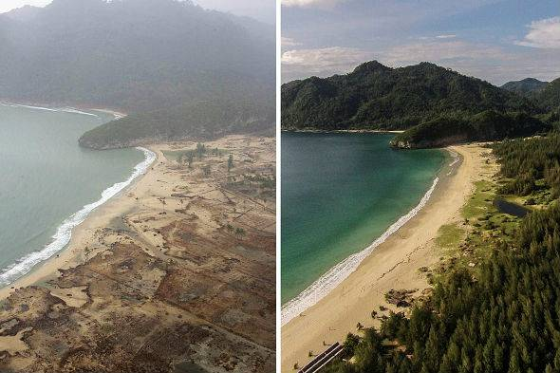
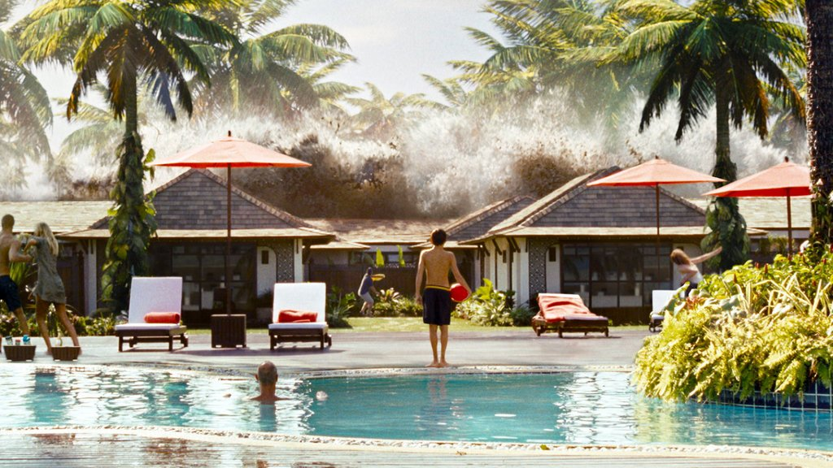
2004,indonesia, Thailand, sri lanka
At Christmas in 2004 affected Indonesia destructive earthquake. This earthquake caused tsunamis which ones had inflicted biggest damages not only in Indonesia but also In Thailand and Sri Lanka. Here found death more then 28300 people. In epicenter, earthquake had intensity 9,15 magnitude.

