Slide 1
Žilina

Slide 2
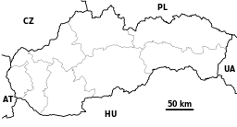
Žilina
Location: Žilina is situated in the north of Slovakia.
City and population: It is the third largest city of Slovakia with a population of 85,000. Žilina is the largest city on the Váh river. The city is surrounded by these mountains: Malá Fatra
Súľovské vrchy
Javorníky
Kysucká vrchovina

Slide 3
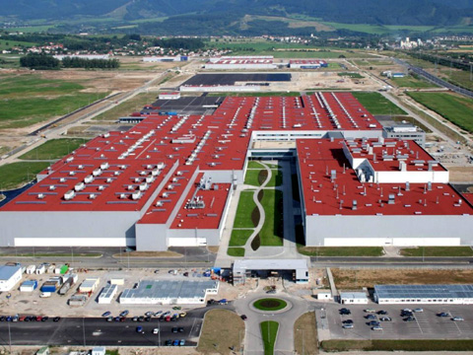
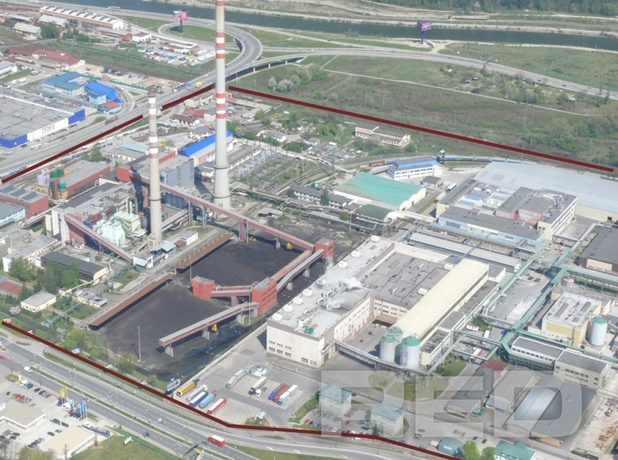
Industry
Žilina is the very industrial city. The biggest and most important factory is Korean car maker Kia Motors. In 2009 the factory produced 300,000 cars a year. There is also
Tento, a paper mill company and many others.

Slide 4
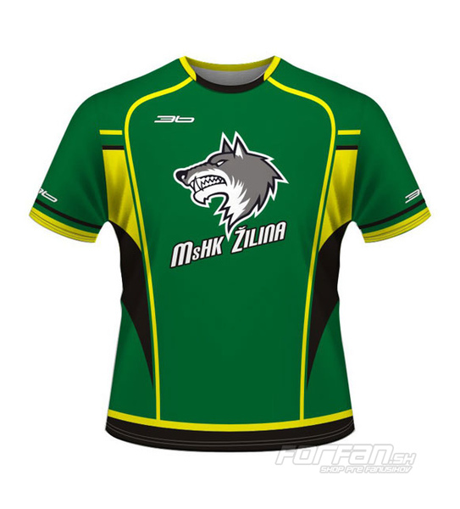
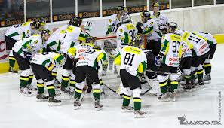
Sport
Football club MŠK Žilina plays in the top Slovak division Corgoň liga and is one of the most successful teams. The team's colors are the yellow and green from the city's flag. Home games are played at the Stadium Pod Dubňom. Ice hockey club MsHK Žilina plays in the Slovak Extraliga.

Slide 5
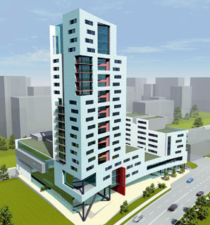
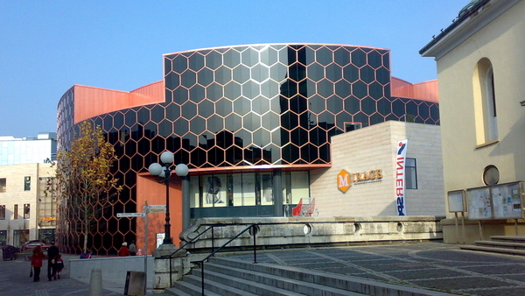
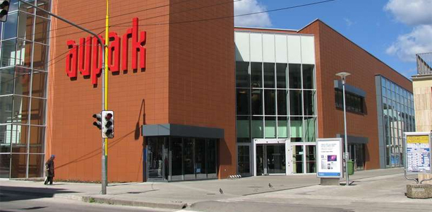
Buildings
Žilina is the city of modern buildings for example large shopping centers: Mirage,Europalace,Carrefour,Aupark...
Žilina is home to two theaters, the City Theater, and the Puppet Theater. The city is home to the University of Žilina and there are 18 public primary schools.Education is here at a high level.

Slide 6
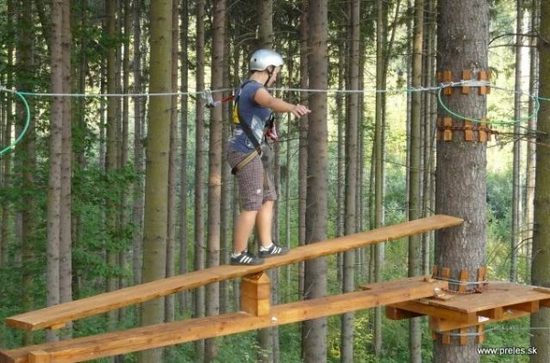
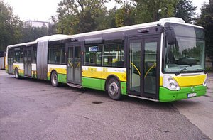
Transport
In the Žilina are many cars, therefore there is air pollution and from Tento factory.
But there are a lot of trolley and there is the international Žilina airport. In the one part of Žilina is forest park and here people can cycling,rollerblading,running and relaxing.

Slide 7
Thank you for watching ☺
Smolka Tomáš I.E
2012/13

