Slide 1
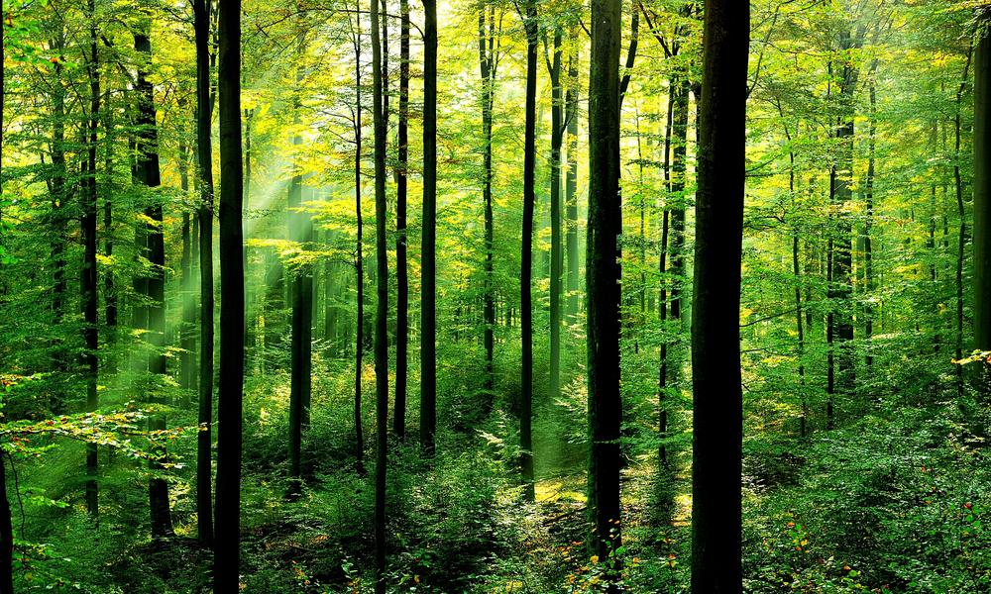
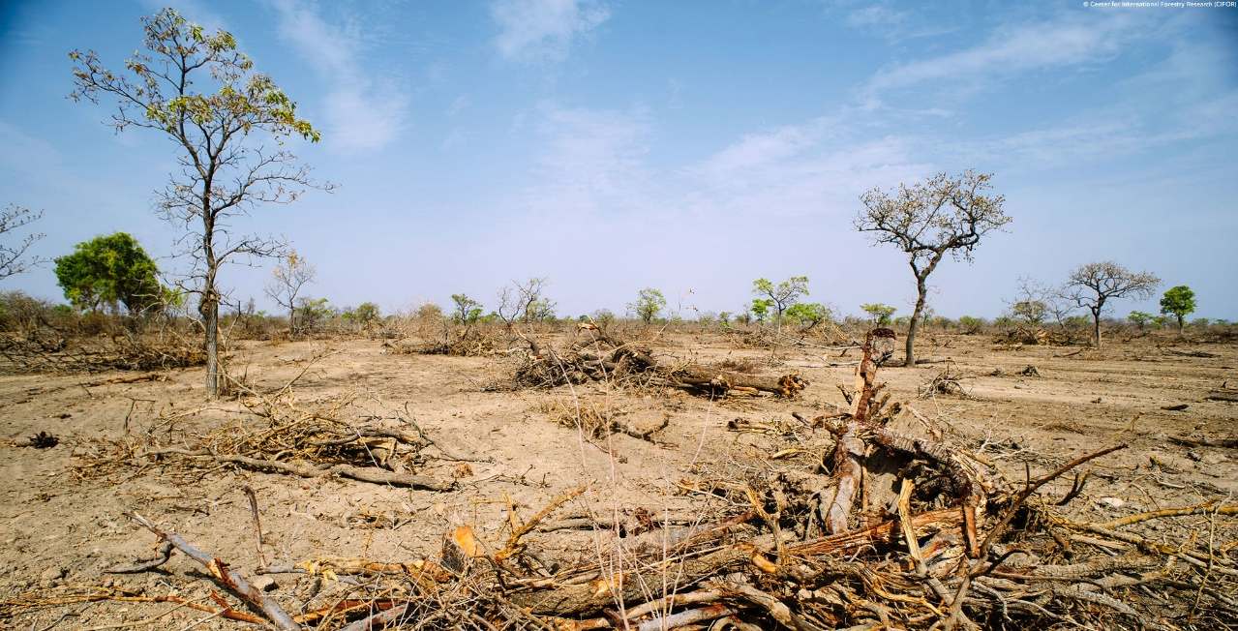
Deforestation
Enviromental Problem
Marcel Jakubjak
II.D
S.P.S.Š Žilina

Slide 2
Environmental problem is in the human comfort. People deforested forests only for their own benefit. Daily cutting of about 100,000 square kilometeter of forest. Of these, 32% used in the economy, 8% used as fuel and the remaining 60% as a building material. People do not realize the consequences of deforestation. Deforestation causes: landslides, smaller produce of oxygation and animals must go closer to human settlement looking for food.

Slide 3
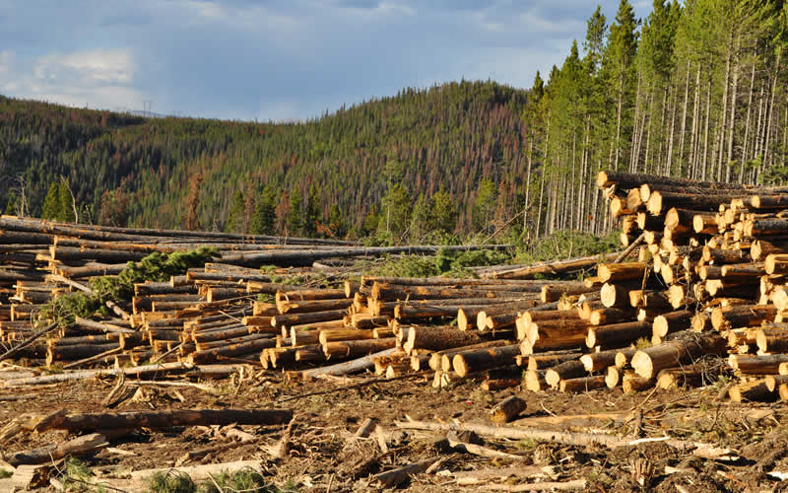

Slide 4
The reason for deforestation is production wood, arable land, construction of highways and towns. Most of deforestation occurs in fires. Fire destroys large tracts of forests that are important for the environment. The causes of deforestation include the change of the country and the death of animals. Earth is all we have. It needs to be protected and not destroyed.

Slide 5
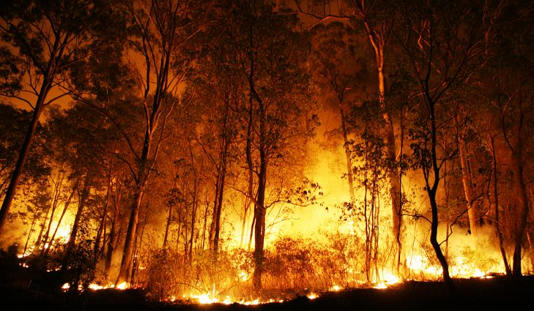

Slide 6
Source:
https://www.google.sk/search?client=opera&dcr=0&biw=1733&bih=847&tbm=isch&sa=1&ei=rh5uWqrBGc_dwQLWmaf4DA&q=fire+forest&oq=fire+forest&gs_l=psy-ab.3..0i19k1l6j0i30i19k1j0i8i30i19k1l3.131490.133803.0.134043.11.11.0.0.0.0.98.848.11.11.0....0...1c.1.64.psy-ab..0.11.846...0j0i67k1j0i10k1j0i30k1j0i10i30k1.0.xiwsMtQXx-4#imgrc=iOgQyc2VzM2YeM:
https://www.google.sk/search?client=opera&dcr=0&biw=1733&bih=847&tbm=isch&sa=1&ei=VB5uWrbjJI3awQKb46aAAQ&q=deforestation&oq=defores&gs_l=psy-ab.3.0.0l3j0i30k1l7.86829.88067.0.89269.7.6.0.1.1.0.75.417.6.6.0....0...1c.1.64.psy-ab..0.7.420...0i67k1.0.nT3FzqSAmd0#imgrc=8veDNFJIGYg7AM:
https://www.google.sk/search?client=opera&dcr=0&biw=1733&bih=847&tbm=isch&sa=1&ei=VB5uWrbjJI3awQKb46aAAQ&q=deforestation&oq=defores&gs_l=psy-ab.3.0.0l3j0i30k1l7.86829.88067.0.89269.7.6.0.1.1.0.75.417.6.6.0....0...1c.1.64.psy-ab..0.7.420...0i67k1.0.nT3FzqSAmd0#imgrc=yjGO8jD8yXO8TM:
https://www.google.sk/search?client=opera&dcr=0&biw=1733&bih=847&tbm=isch&sa=1&ei=rh5uWqrBGc_dwQLWmaf4DA&q=forest&oq=forest&gs_l=psy-ab.3..0i67k1l2j0l8.44461.45471.0.46022.6.5.0.1.1.0.102.383.4j1.5.0....0...1c.1.64.psy-ab..0.6.386....0.PIS5niRzERY#imgrc=ihce6Wrry3M0ZM:
http://www.oskole.sk/?id_cat=16&clanok=95

